Slide 1

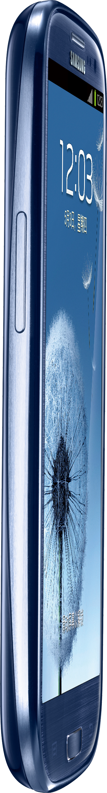




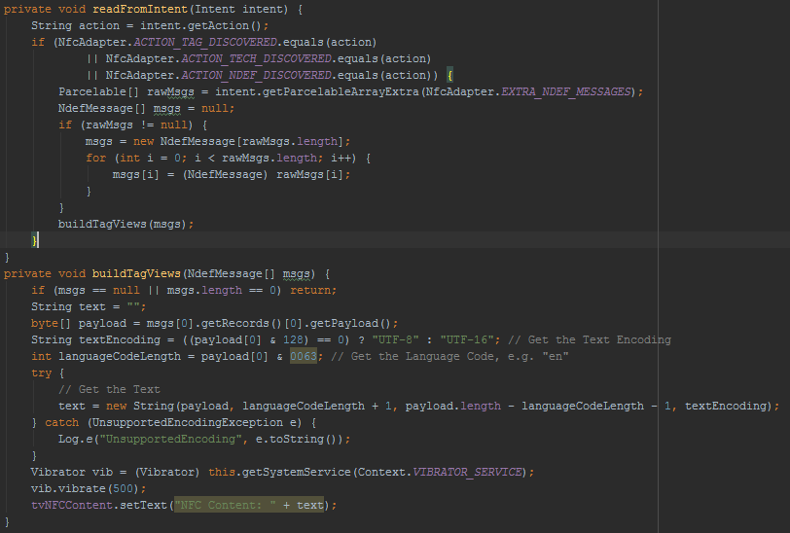
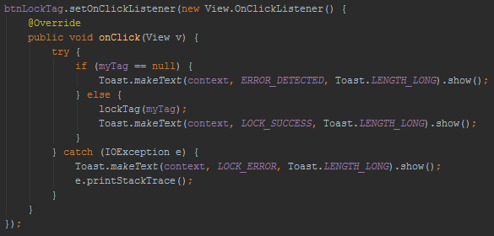


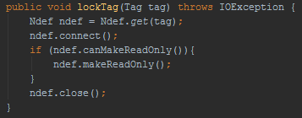
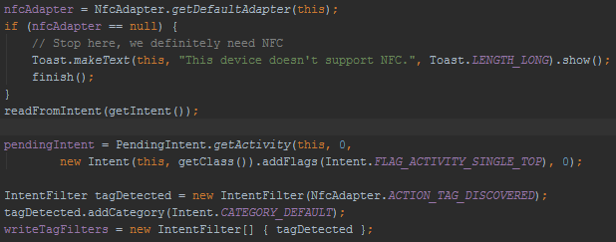


[STATIC LOCK BYTES] - Field Programmable Read-Only Locking Mechanism
[MEMORY LOCATION] - PAGE 02h (Hex)
[DETAILS] - Each bit represents an individual 16-bit page from 03h to 0Fh. Bits set to 1 permanently lock their corresponding pages as read-only.
L7 | L6 | L5 | L4 | L CC | BL 15-10 | BL 9-4 | BL CC
L 15 | L 14 | L 13 | L 12 | L 11 | L 10 | L 9 | L 8
COURSE INFORMATION
CNT 4514C: Wireless Networks and Mobile Computing
Professor Zornitza Genova Prodanoff
Spring Term 2017
[CAPABILITY CONTAINER] - One Time Programmable Bits
[MEMORY LOCATION] - PAGE 03h
[DETAILS] - Writability defined by Static Lock Bytes. Stores control data for managing NFC Forum defined data inside the tag.
CONTACT
LOCK0
LOCK1
Christopher Small
N00931863@ospreys.unf.edu
E1 | 10 | 12 | 00
Magic Number | NFC Type 2 Version Number | Data Area (144 Bytes) | R/W Access (No Security)
OTP1
[DYNAMIC LOCK BYTES] - Position Based Locking
[MEMORY LOCATION] - DYNAMIC
[DETAILS] - Used to lock discrete memory blocks after PAGE 15h.
OTP0
OTP2
OTP3
LOCK2
LOCK3
LOCK4
04 34 CB 73 2A 74 40 81 9F 48 00 00 E1 10 12 00 01 03 A0 0C 34 03 00 FE 00 00 00 00 00 00 00 00 00 00 00 00 00 00 00 00 00 00 00 00 00 00 00 00 00 00 00 00 00 00 00 00 00 00 00 00 00 00 00 00 00 00 00 00 00 00 00 00 00 00 00 00 00 00 00 00 00 00 00 00 00 00 00 00 00 00 00 00 00 00 00 00 00 00 00 00 00 00 00 00 00 00 00 00 00 00 00 00 00 00 00 00 00 00 00 00 00 00 00 00 00 00 00 00 00 00 00 00 00 00 00 00 00 00 00 00 00 00 00 00 00 00 00 00 00 00 00 00 00 00 00 00 00 00 00 00 00 00 00 BD 04 00 00 FF 00 05 -- -- FF FF FF FF 00 00 -- --
NEAR FIELD COMMUNICATION
04 34 CB 73 2A 74 40 81 9F 48 F8 FF E1 10 12 0F 01 03 A0 0C 34 03 3A 91 01 08 54 02 65 6E 53 54 41 52 54 54 0F 1C 61 6E 64 72 6F 69 64 2E 63 6F 6D 3A 70 6B 67 63 6E 74 34 35 31 34 63 2E 75 6E 66 73 79 6D 70 6F 73 69 75 6D 6E 66 63 71 75 69 7A FE 00 00 00 00 00 00 00 00 00 00 00 00 00 00 00 00 00 00 00 00 00 00 00 00 00 00 00 00 00 00 00 00 00 00 00 00 00 00 00 00 00 00 00 00 00 00 00 00 00 00 00 00 00 00 00 00 00 00 00 00 00 00 00 00 00 00 00 00 00 00 00 00 00 00 00 00 00 00 FF 01 00 BD 04 00 00 FF 00 05 -- -- FF FF FF FF 00 00 -- --
OTP0
OTP1
LOCK1
OTP2
OTP3
LOCK0
LOCK3
LOCK2
LOCK4
LOCKED
REFERENCES
M. Roland and J. Langer, "Digital Signature Records for the NFC Data Exchange Format," 2010 Second International Workshop on Near Field Communication, Monaco, 2010, pp. 71-76. doi: 10.1109/NFC.2010.10
B. Jepson, D. Coleman, and T. Igoe, 4. Introducing NDEF [Book]. Safari, 2017. [Online]. Available: https://www.safaribooksonline.com/library/view/beginning-nfc/9781449324094/ch04.html. Accessed: Feb. 2, 2017.
NFC, Forum. "NFC Forum Technical Specifications Improve RF Communication and NFC Tag Interoperability with NFC Devices." Business Wire (English) Dec. 0010: Regional Business News. Web. 1 Feb. 2017.
electrical 4 u, "Air core transformer," 2011. [Online]. Available: http://www.electrical4u.com/air-core-transformer/. Accessed: Feb. 1, 2017.
NFC Forum, 1st ed. NFC Data Exchange Format (NDEF) Technical Specification, 1st ed. Wakefield, MA: NFC Forum, 2006. Web. 27 Mar. 2017.

Slide 2
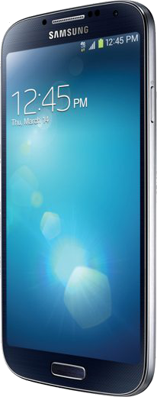
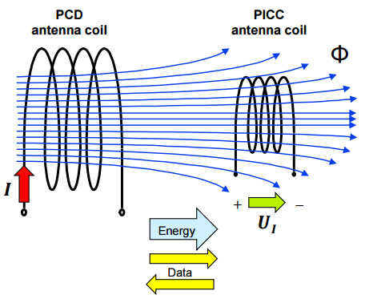
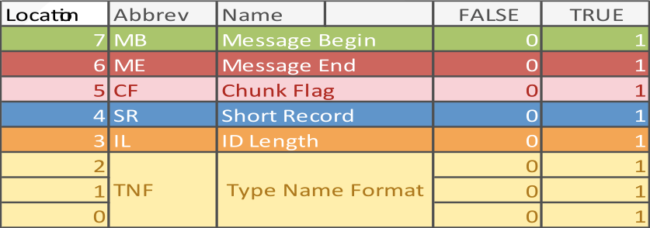
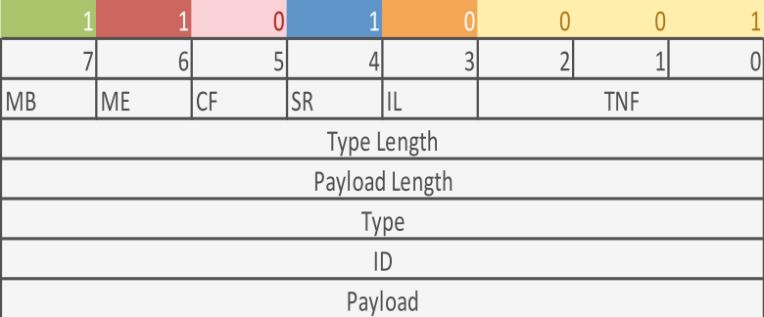
ISO/IEC 14443 specifies the characteristics of the fields to be provided for power and bi-directional communication between proximity coupling devices (PCDs) and proximity cards or objects (PICCs).
INTRODUCTION
Smartphone devices that are NFC-enable operate in reader/writer mode, one of three modes defined by the NFC Forum, when interfacing with passive NFC tags. RF interfaces must be compliant with in order to generate, transmit, and receive messages on ISO/IEC 18000-3 air interface which describes the parameters for air interface communications at 1the ISO 14443 standard 3.56 MHz.
Near Field Communication (NFC) was developed to enable contactless transmission of data. This poster focuses on the electromechanical properties of technology that can generate a message using an Android device (smartphone) and illustrating the standardized format of a typical message facilitating the exchange (NDEF). //add references
Fig. 1
Figure 1 illustrates how a controlled electric current applied to an antenna coil attached to the powered device actively generates a directed electromagnetic field. NFC technology makes use of a phenomenon called electromagnetic induction. The presence/absence of this field over time is used to logically generate a stream of binary data bits.

